Slide 1
P20 on Ag 100

Slide 2
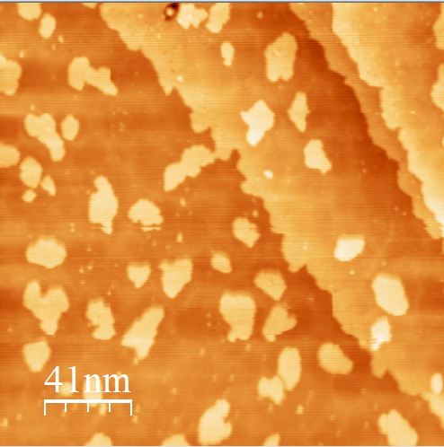
1< Lagen
3dig bei 27s/dig
Kanten nicht scharf wie bei silber
Bildung von inseln auf der ersten lage
Keine geordnete struktur
Pigmente sichtbar -> indikator für monolage auf silber
Silber bildet keine halbinsel an kanten

Slide 3
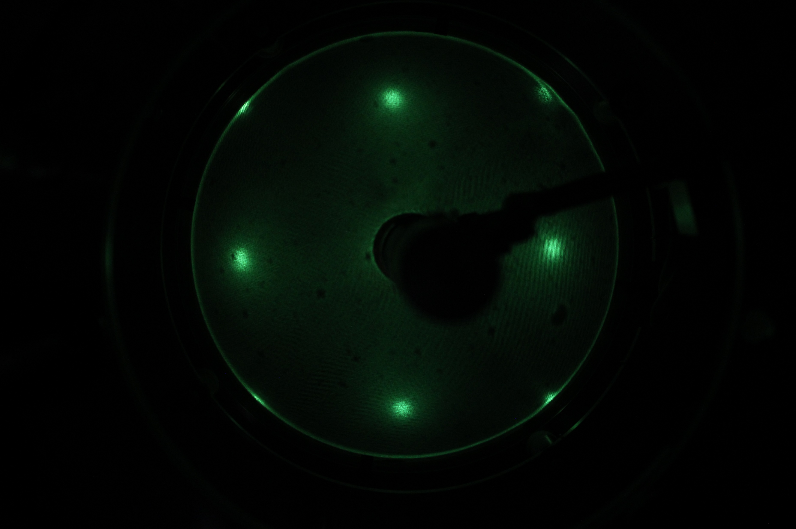
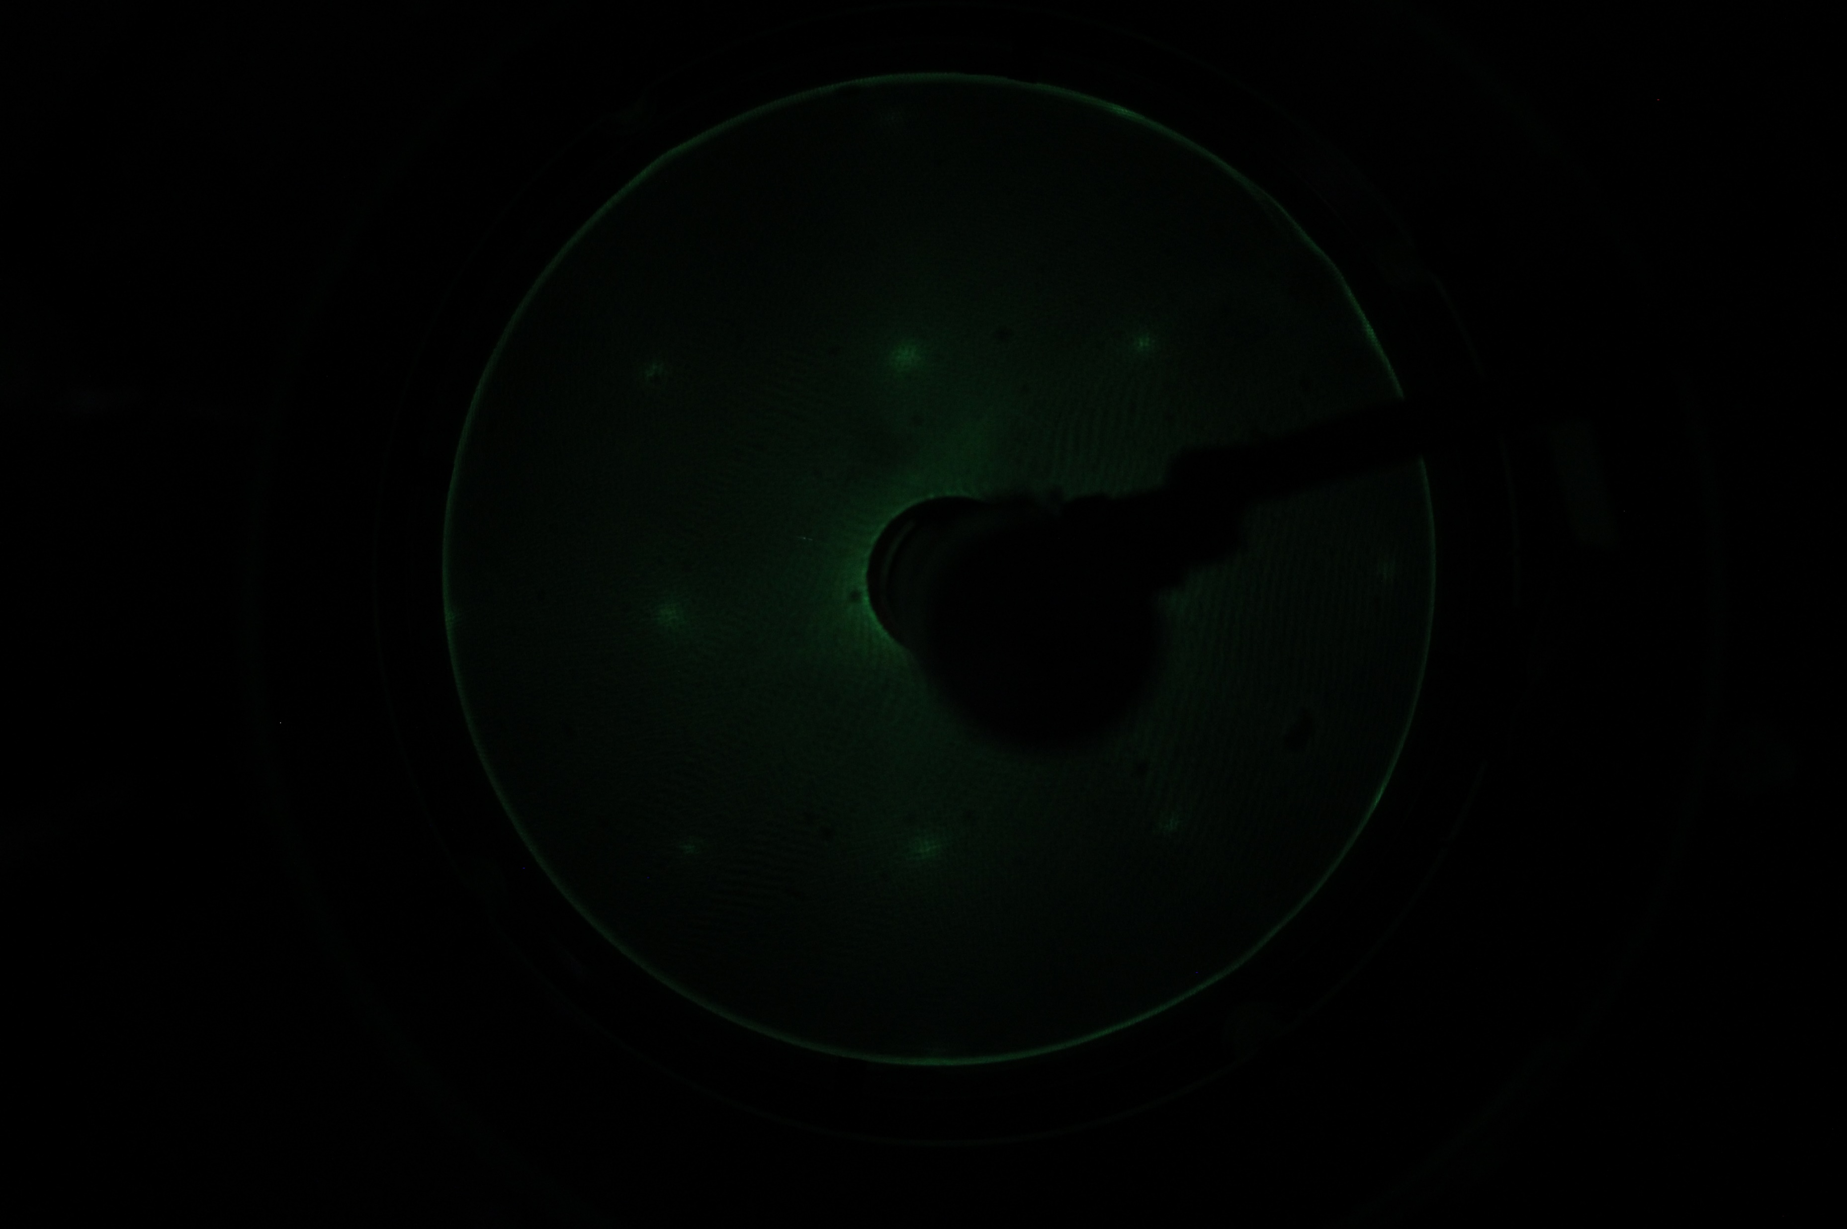
30 eV
69 eV
LEED before cleaning
Fcc structure visible
A bit difuse
Inner peaks disapear at 240 °C
Outer peaks fade away at 300 °C

Slide 4
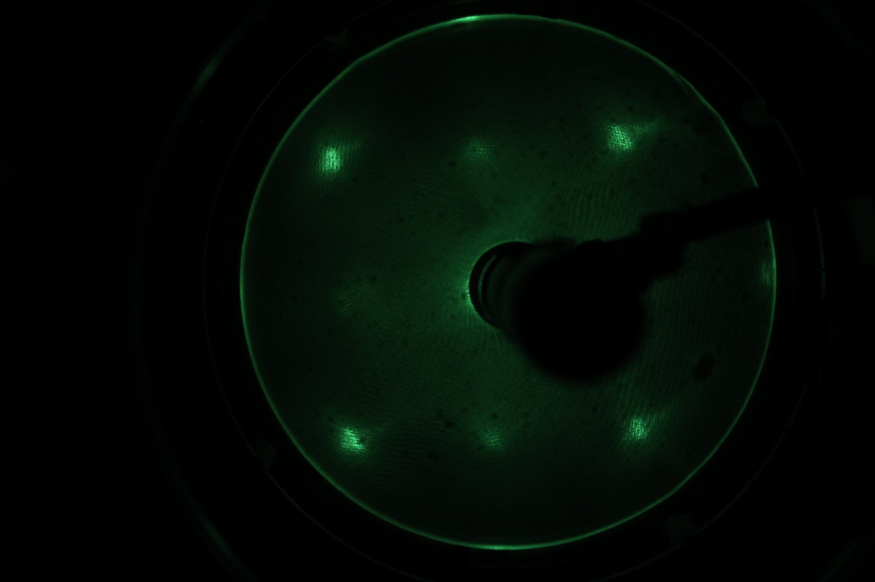
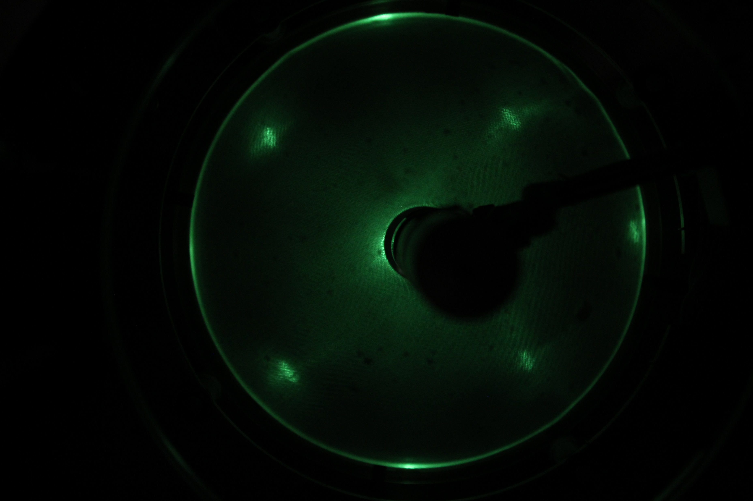
60 eV After 5x sputter/anneal at 500 °C
60 eV 1 dig -> 35s/dig
Nach cleaning erste ordung verschwindet

Slide 5
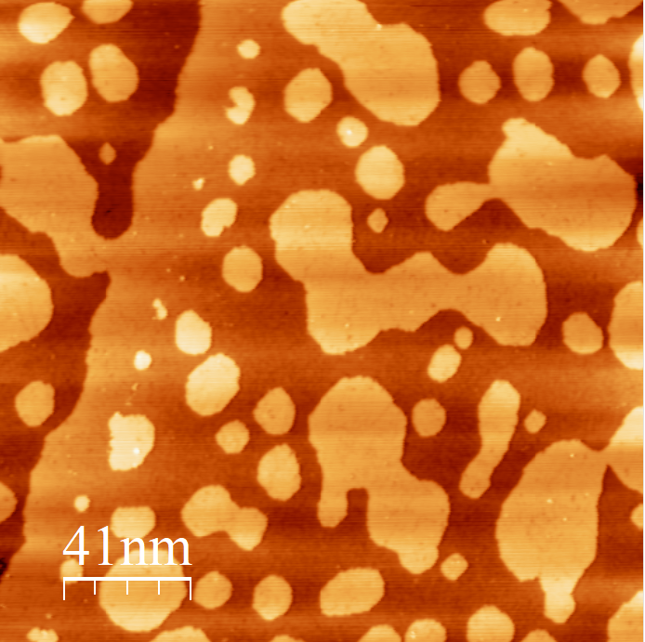
25.04
More than 1 ML
1 dig -> 45s/dig
Still no clear structure
Not mobile at 75 K

Slide 6
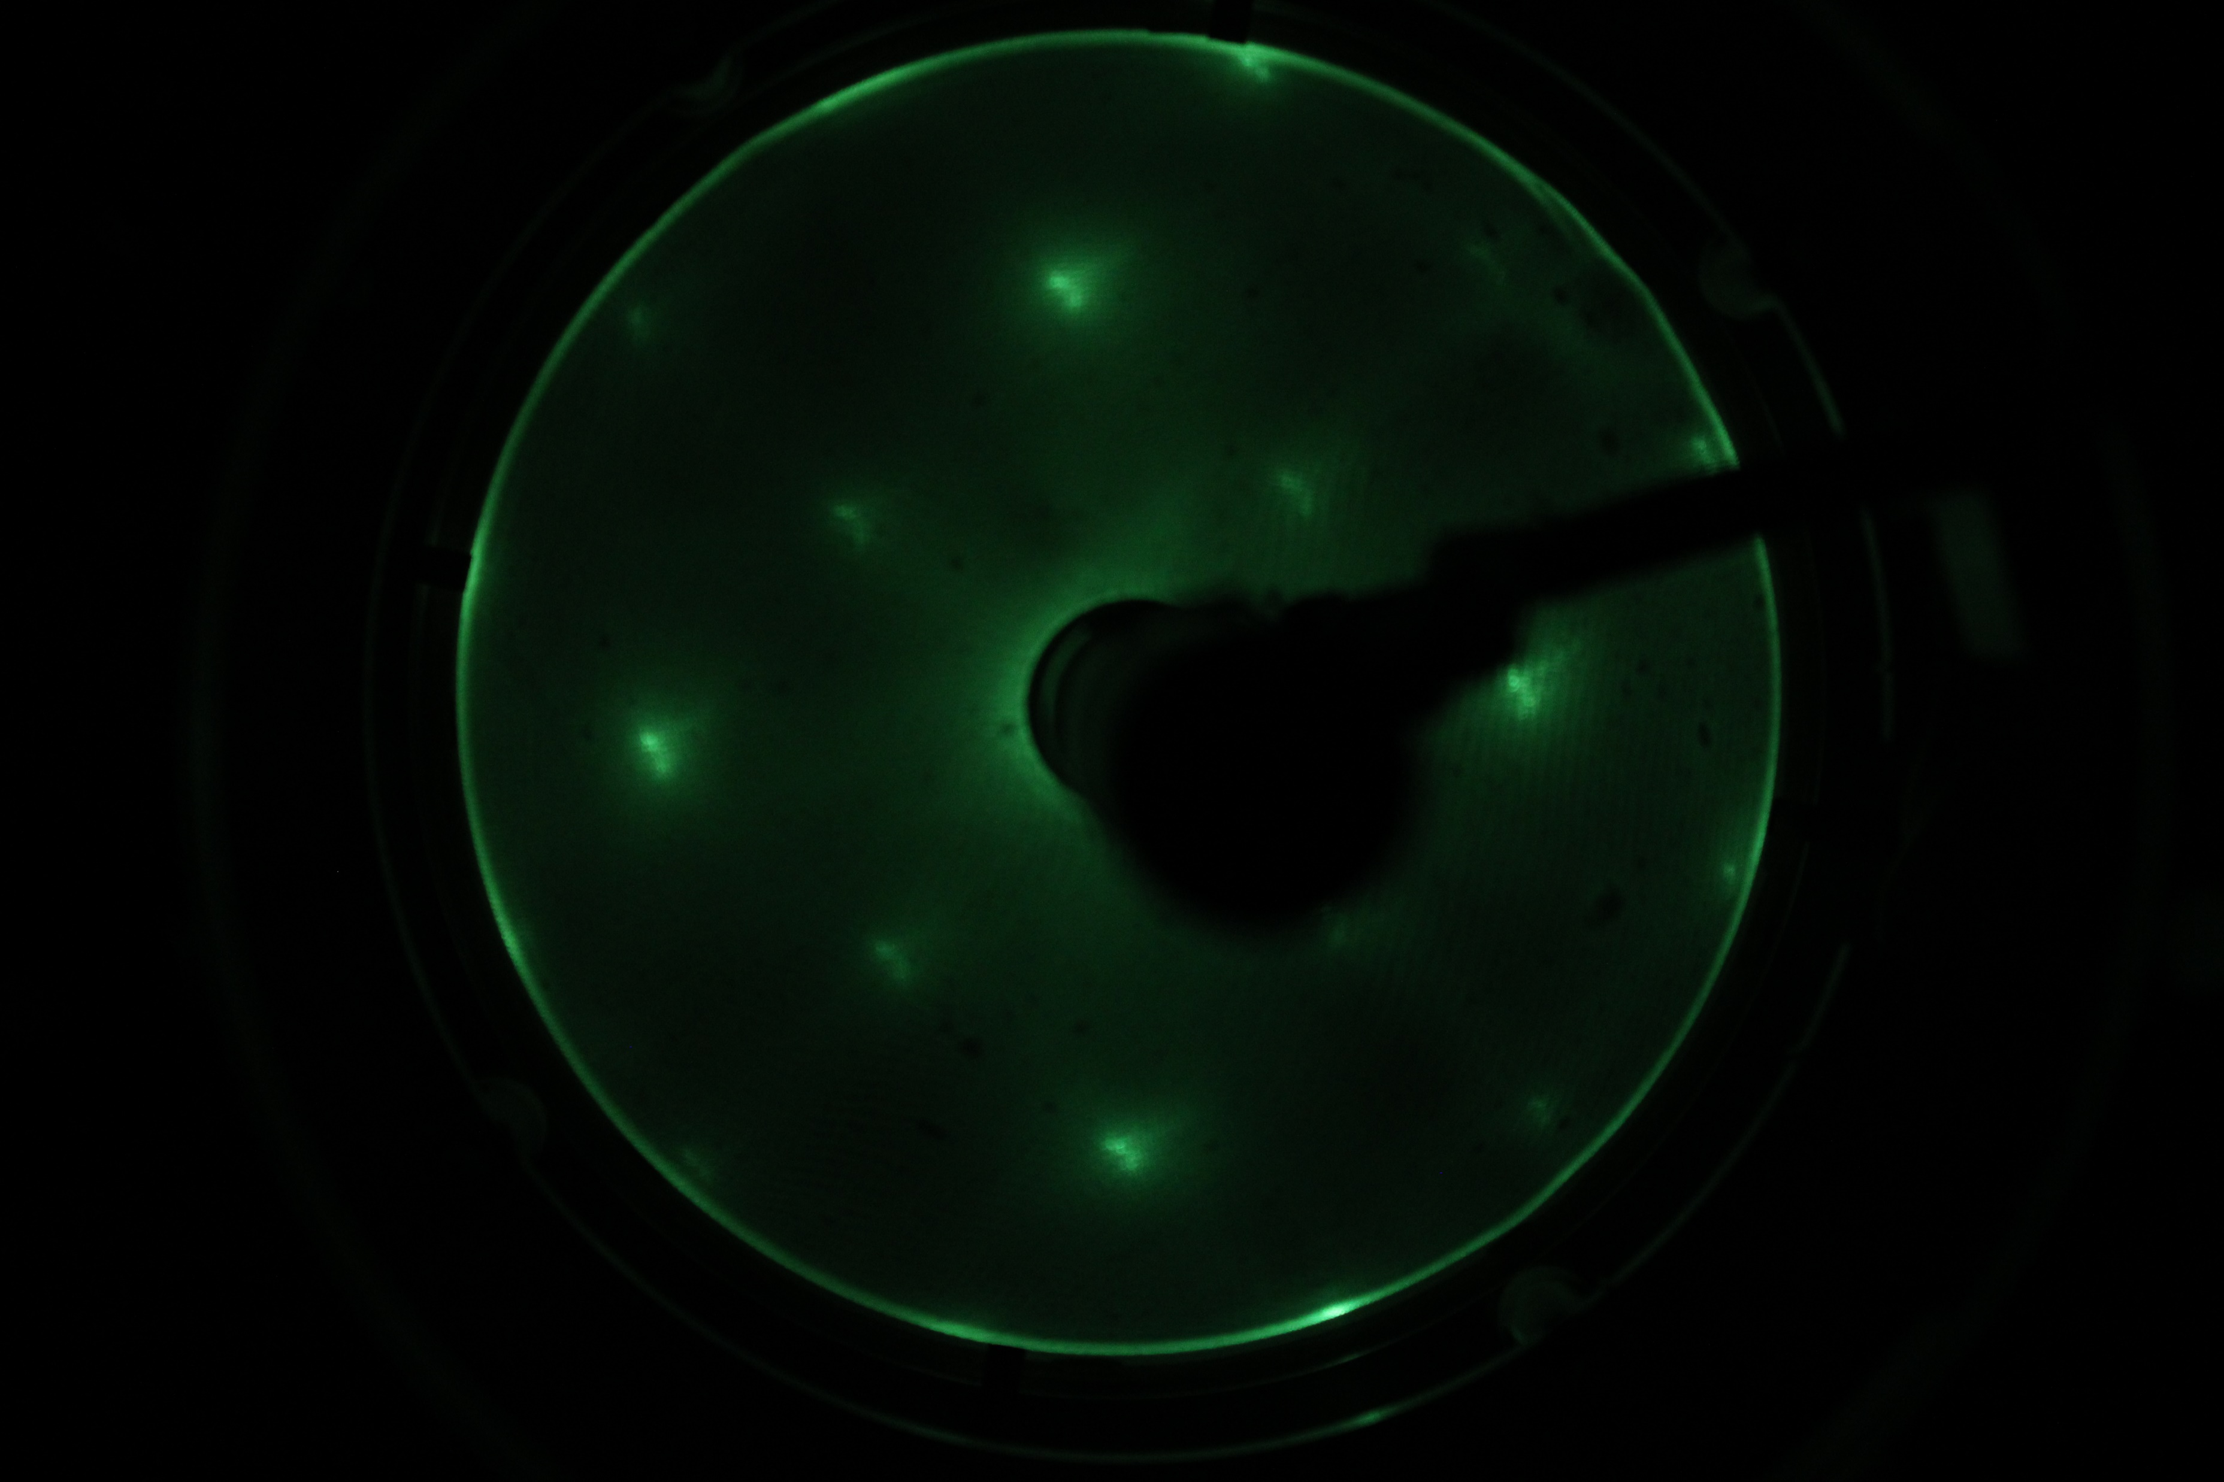
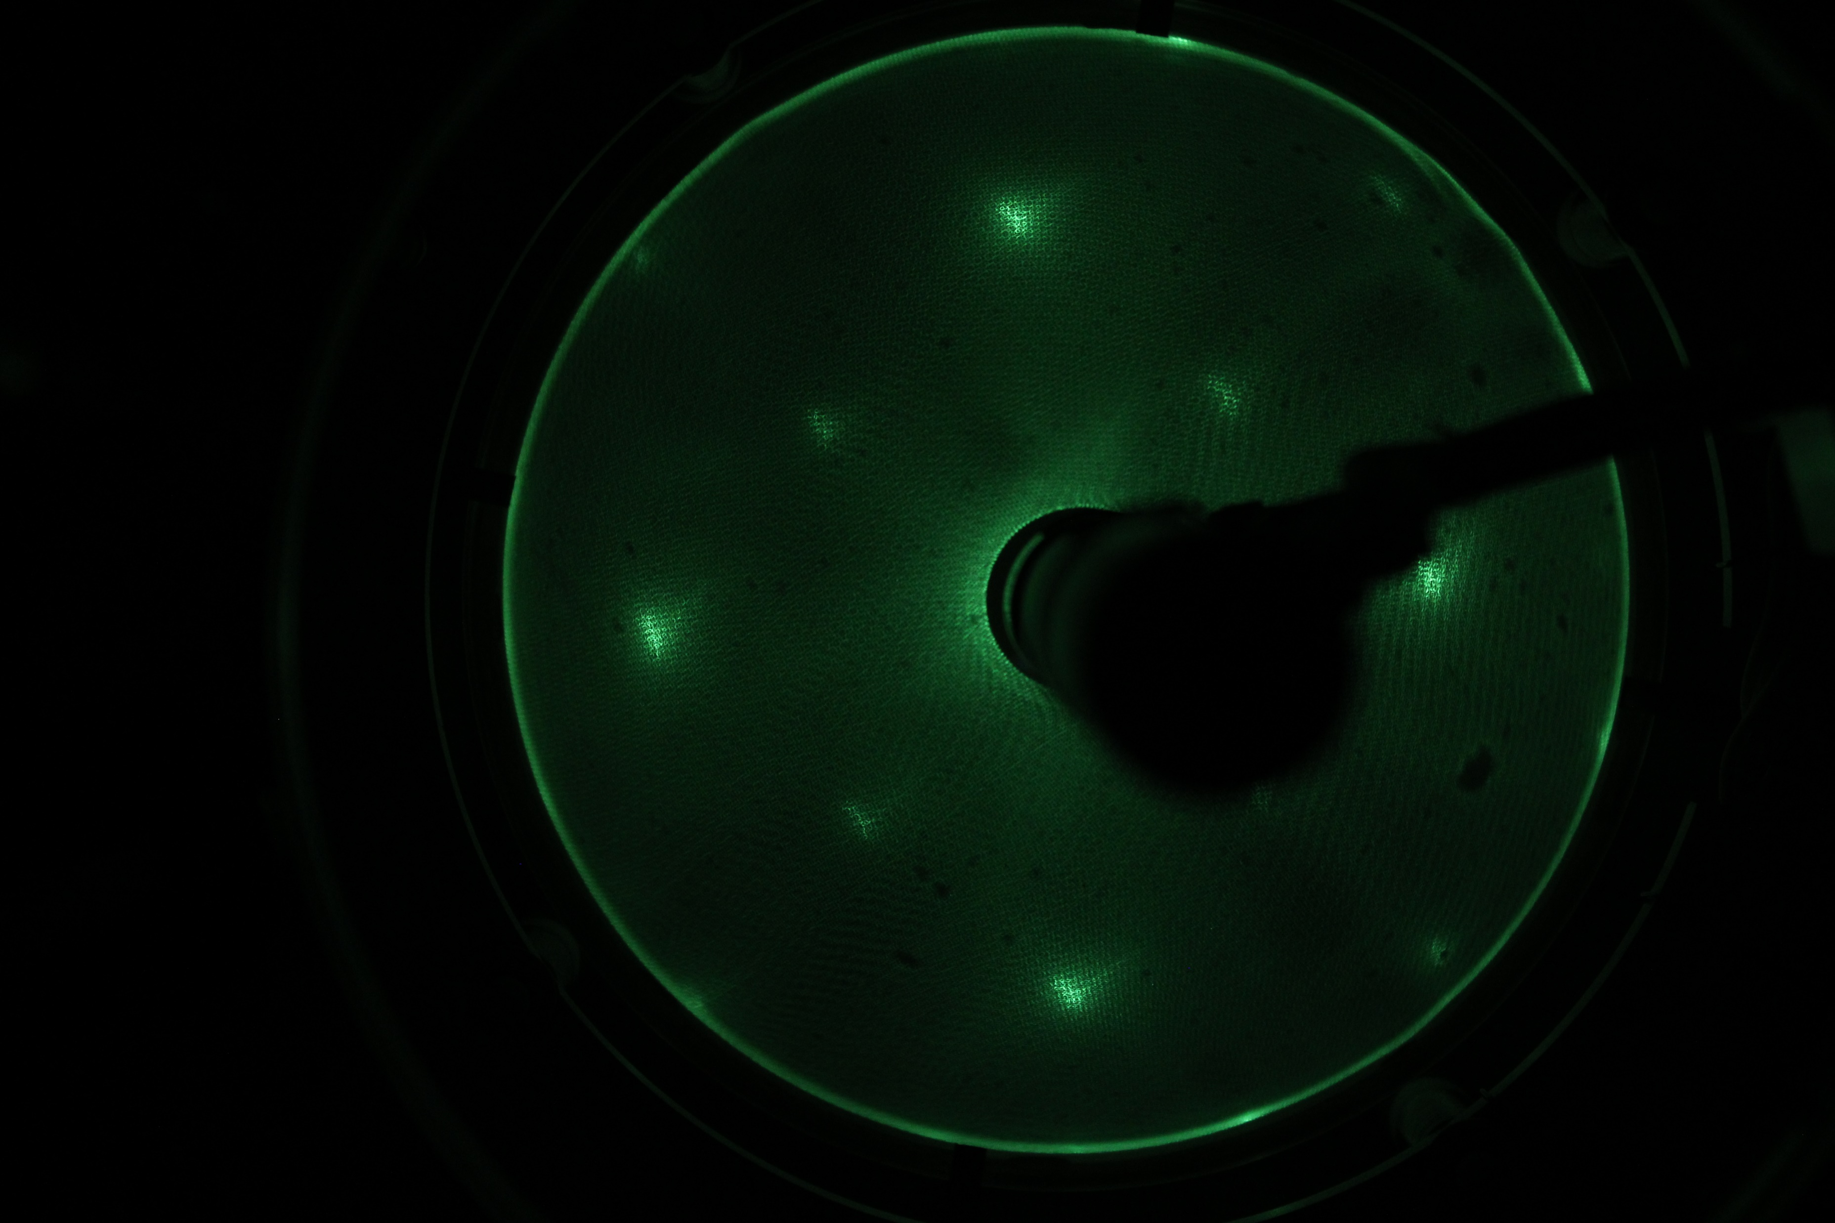
144eV
After cleaning 3x Sputter/annealing 500 C°
With P20 1 dig -> 35s/dig

Slide 8
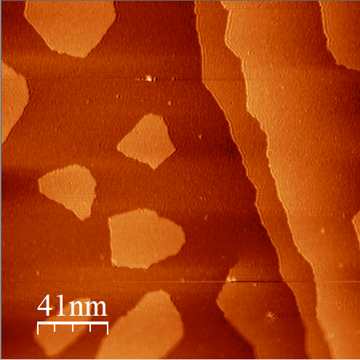
Neue präparation 1 dig bei 35s/dig
Kanten schärfer -> womöglich inseln direkt auf silber
Inseln bilden wieder keine geordnete struktur
Keine direkte aussage über die anordnung von P20

Slide 9
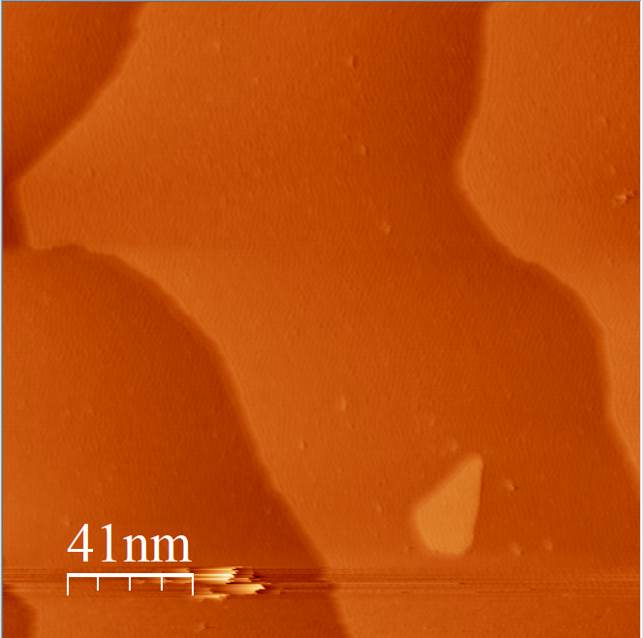
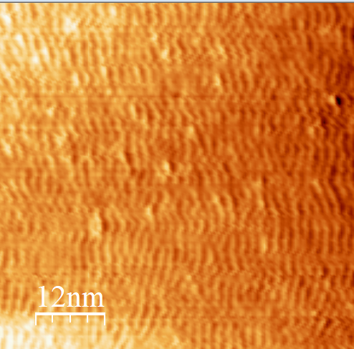
Between the island there is no Ag structure present
More the 1 ML

Slide 10
2HPc on Ag 100

Slide 11
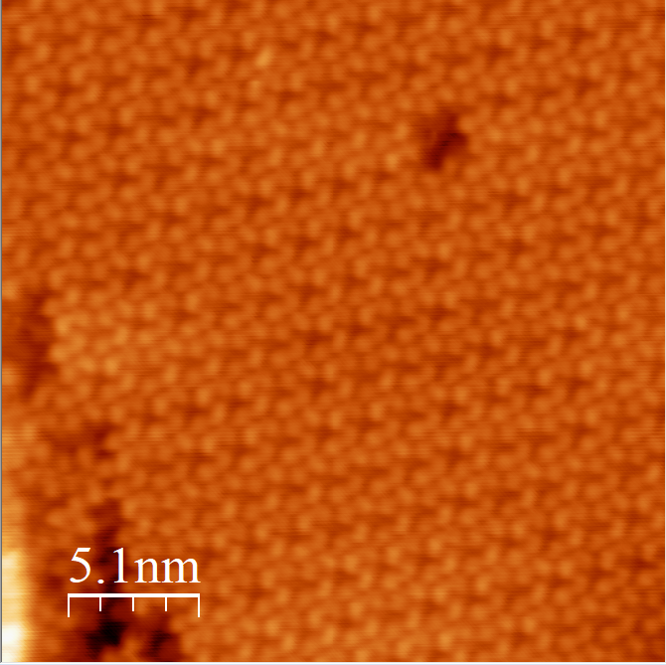
3 dig -> 30s/dig
0.52 V
Clear ordered structure visible
rotation approx. 30° relative to substrate

Slide 12
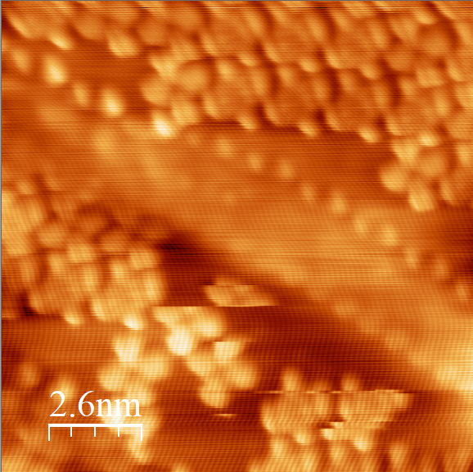
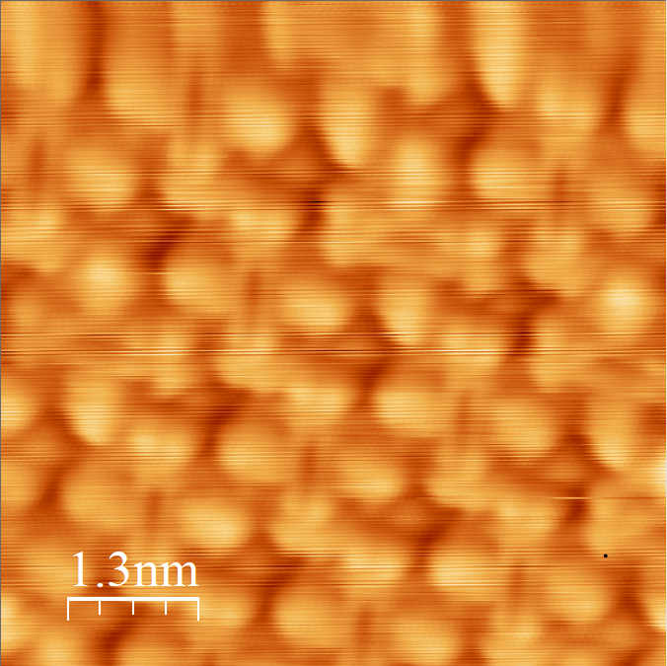
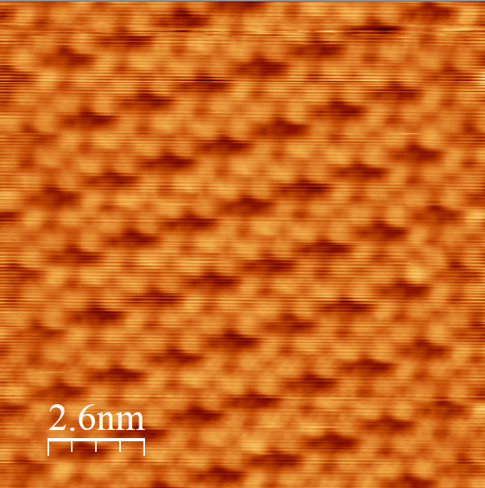
-0.7 V
-0.05 V
0.77 V
LUMO visable near the fermi level

Slide 13
0.7 V
Two axis of alignment for Lumo
0.1 V

Slide 14
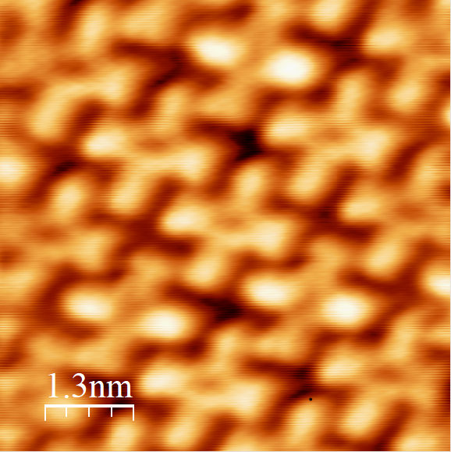
-0.10 V
Submonolayer-monolayer
Lack of islands
Not mobile
Phase?
Four leaf feature with a depression in the middle for positive polarisation
Asymmetric LUMOs visable for negative polarisation
LUMOS degenerate with two clearly visible orientations
2HPc aranged so that the benzene ring of one molecule points to the benzene ring of the neares neighbor

Slide 15
MgO

Slide 16
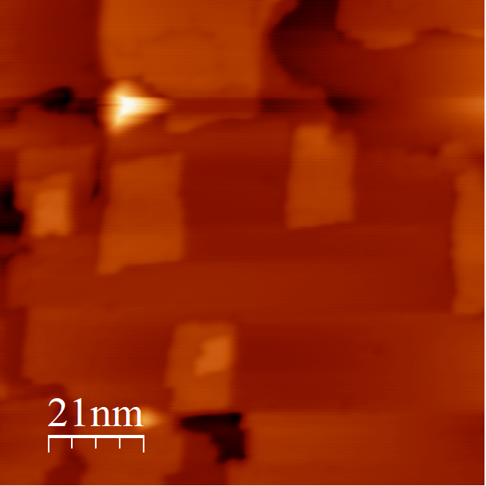
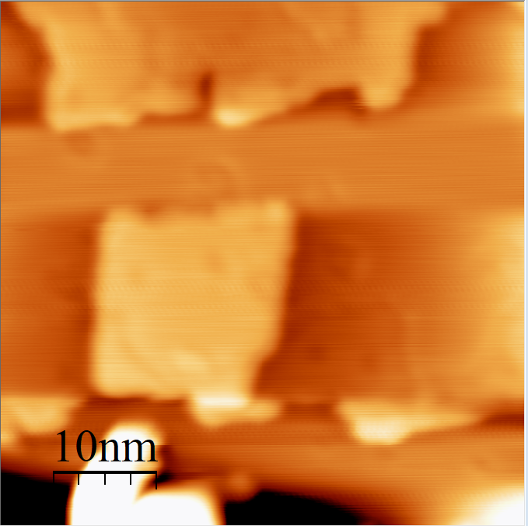
3.5 V
MgO makro crystal structure visiable
Rectangular Plateau´s

Slide 17
2HPc on Mg0/Ag100

Slide 18
2HPc/MgO Summary
Structure: Superlattice + oreintation clear and good LEED images, large scale distribution of different molecular species not known
Atleast 3 molecular species, ‚normal‘, bright and extra bright
Normal: presumably uncharged
Bright: STS + dI/dV indicate most likely singlycharged with SOMO/SUMO splitting -> Why 4-fold symmetry when LUMO only has 2-fold symmetry?
extra bright: very similar in structure as bright molecues but different dependence on bias, could be defects, metallation,… cannot tell with our data

Slide 19
0.21 V
0.2 V

Slide 20
0.2 V
0.7 V

Slide 21
0.7 V

Slide 22
-0,40V

Slide 23
+0,43V

Slide 24
+0,82V

Slide 25
